Slide 1

UNIVERSITY INSTITUTE OF COMPUTING
Agile Methodology
(24CAT-656)

Slide 2
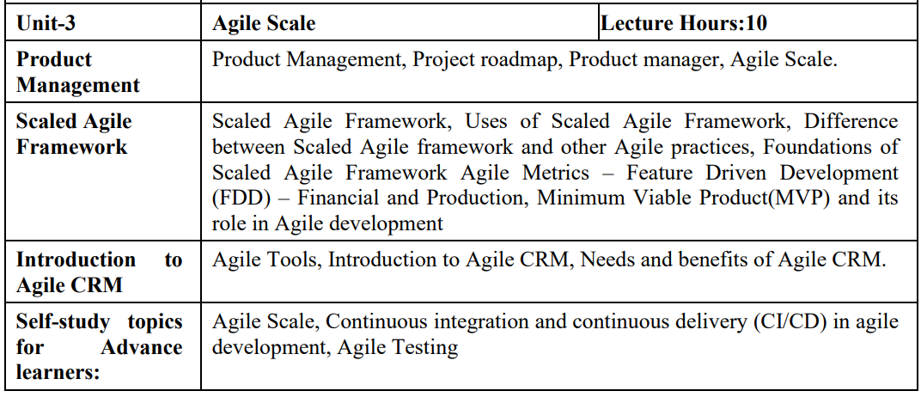
SYLLABUS
2

Slide 3
CONTENT OF THE SYLLABUS
TEXT BOOKS
T1 David J. Anderson and Eli Schragenheim, Agile Management for Software Engineering: Applying the Theory of Constraints for Business Results, Prentice Hall, 2003.
T2 Hazza and Dubinsky, Agile Software Engineering, Series: Undergraduate Topics in Computer Science, Springer, 2009.
T3 Agile Software Development Ecosystems by Jim Highsmith, Addison-Wesley 2002, ISBN 0201760436.
REFERENCES
R1 Craig Larman, Agile and Iterative Development: A Managers Guide, Addison-Wesley, 2004.
R2 Kevin C. Desouza, Agile Information Systems: Conceptualization, Construction, and Management, Butterworth-Heinemann, 2007.
3

Slide 4
Need of Agile CRM
The primary requirement of Agile CRM is broken down into the following points:
Easy-to-use marketing automation: This is easy to use because not every owner of a small businesses should need to understand the technical details of automation.
A manageable CRM: it is easy to use and affordable.
Telephony: There was probably nothing more annoying than seeing someone's phone number on CRM and then dialing their number on our phone. We spent a lot of time in solving our cell phone plans too!
4

Slide 5
Need of Agile CRM
Social suite: Social media playing a vital role in CRM marketing and linking customer with it. If the business owner doesn't incorporate with social media at the very beginning, then they would be left behind.
Full, two-way email integration: The owner wants to integrate personal emails fully into the CRM. So, they can send, receive, and view emails between the owner and their customers inside the CRM itself.
5

Slide 6
Benefit of Agile CRM
The significant benefit of CRM is that the business moves to the centralized platform to store its data. It makes easy access to information from one common source. Due to the presence of best CRM, the organization gets confident to pay attention to their customer without any additional cost.
Before the availability of CRM, the data has scattered across spreadsheets, documents, address book, notebook, and email system. The CRM, simplify this tedious process, and data are access through a centralized location.
6

Slide 7
THANK YOU
For Queries:- ramanjeetsingh.uic@cumail.in

